Slide 1

Mobile Sales Report
-using POWER BI

Slide 2
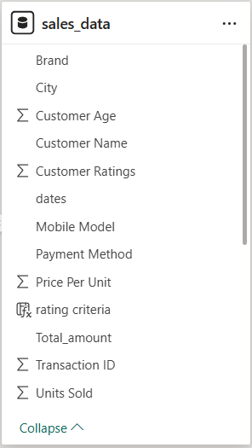
Data Overview
Covering 37 Months Data (October 2021 to October 2024)
Key Matrix 3835 x 13

Slide 3
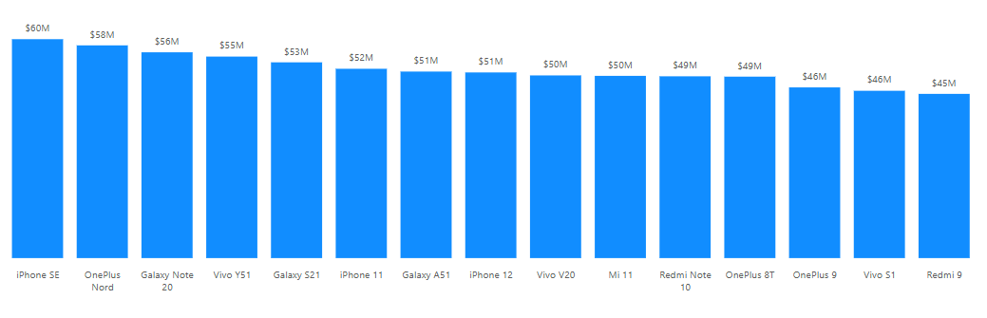
Key Insights & Trends
Model Based Analysis:

Slide 4
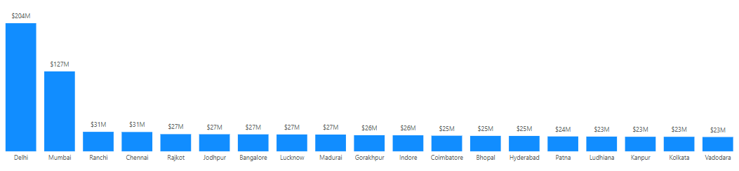
Key Insights & Trends
Location Based Analysis:

Slide 5
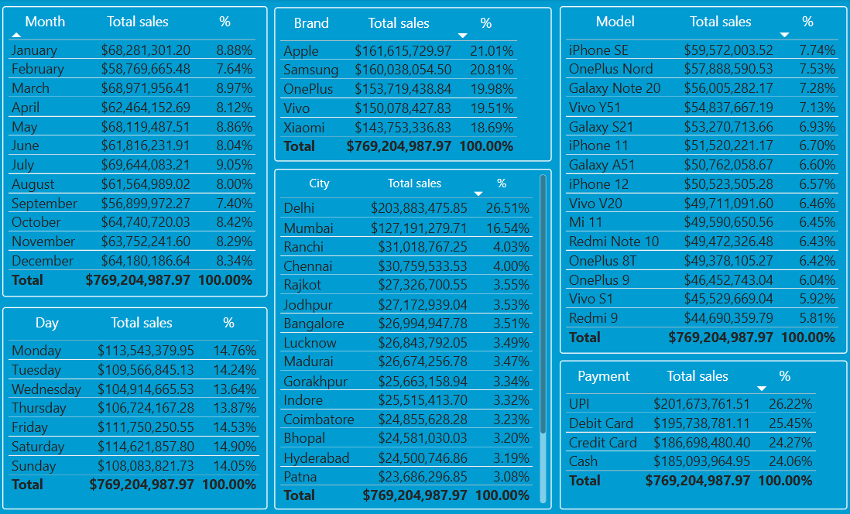
Key Insights & Trends

Slide 6
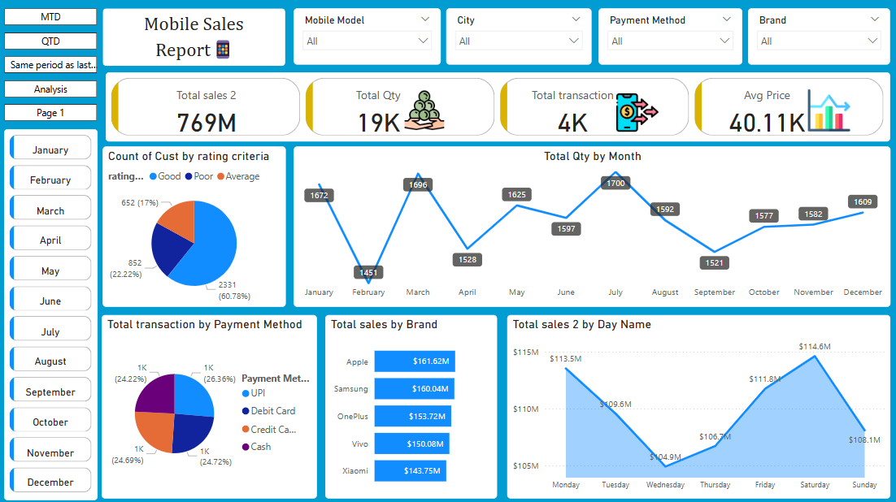
Dashboard

Slide 7
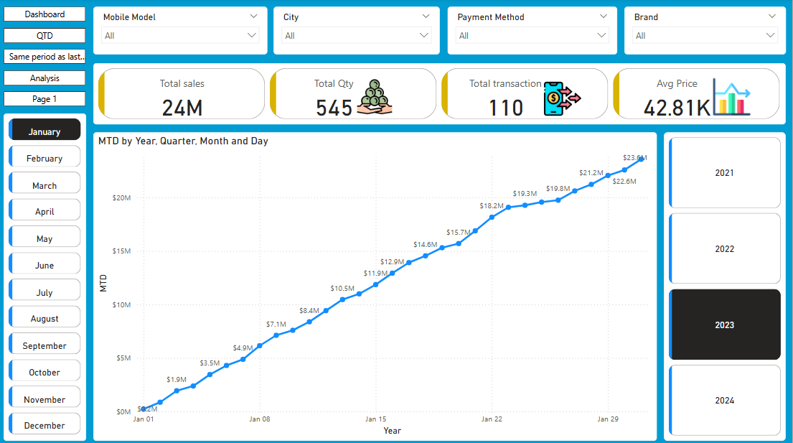
Dashboard

Slide 8
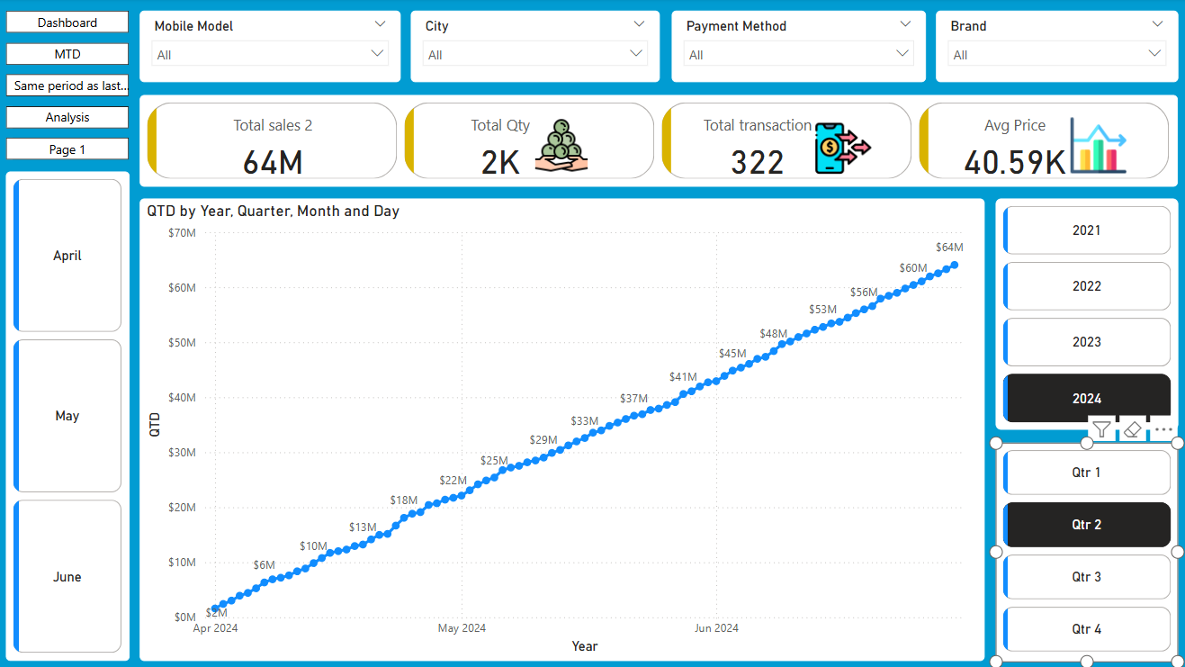
Dashboard

Slide 9
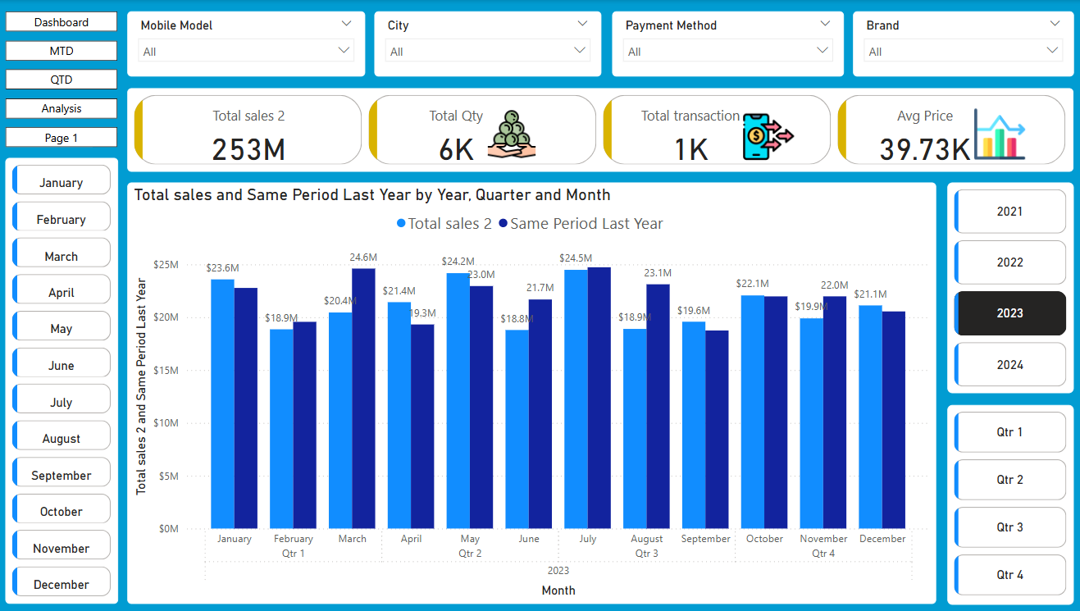
Dashboard

Slide 10
Created Measure
YTD (Year-to-Date): Analyzes cumulative performance from the start of the year to the current date.
QTD (Quarter-to-Date): Cumulative sales from the start of the current quarter to date.
MTD (Month-to-Date): Tracks progress from the beginning of the current month to the present date.
Same Period Last Year: Compares data from the same time period in the previous year to identify trends.

Slide 11
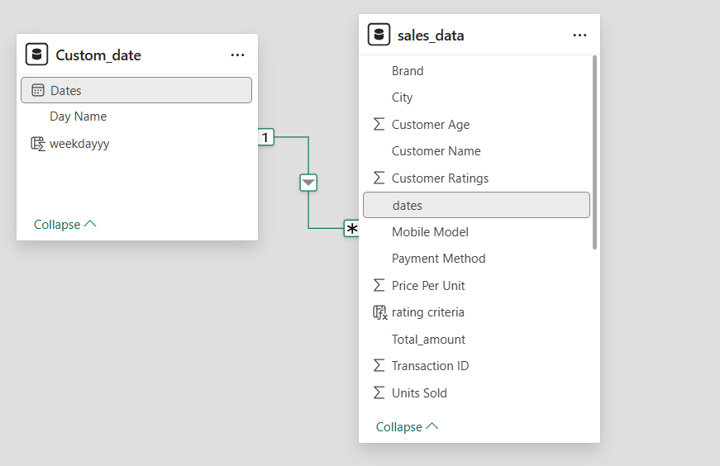
Model View

